Slide 1

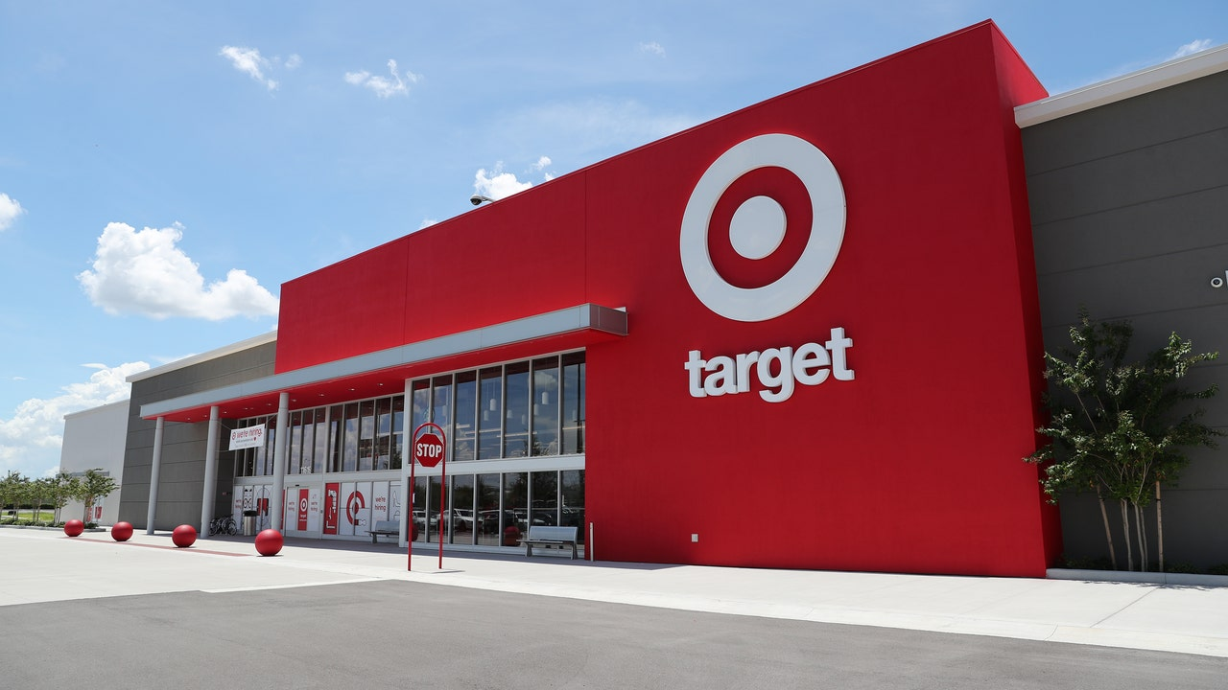

Business Case: Target SQL
The main objective of this analysis on the given Target dataset was to identify trends, patterns, and potential areas for improvement to enhance the company's performance.
Name:- SANTHOSH B
Email Id:- santhoshjune12@gmail.com
Batch:-DSML Nov22 Beginner Morning TTS

Slide 2
1. Import the dataset and do the usual exploratory analysis steps like checking the structure & characteristics of the dataset:

Slide 3


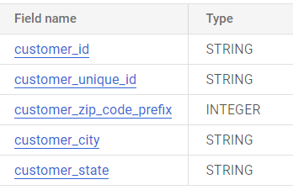
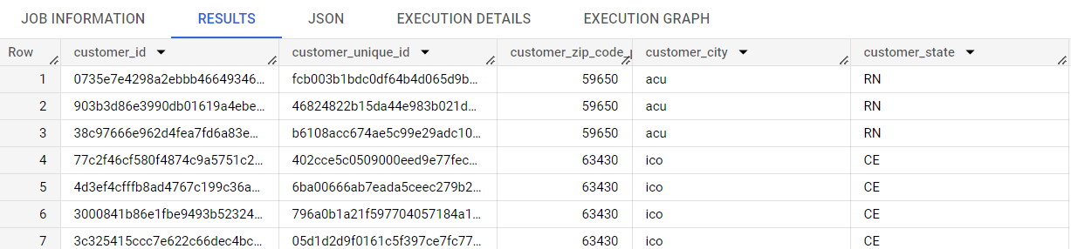
1.1) Data type of all columns in the "customers" table.
The data type of all the columns in the “customer” table are:-
customer_id ---> STRING
customer_unique_id ---> STRING
customer_zip_code_prefix---> INTEGER
customer_city---> STRING
customer_state---> STRING

Slide 4
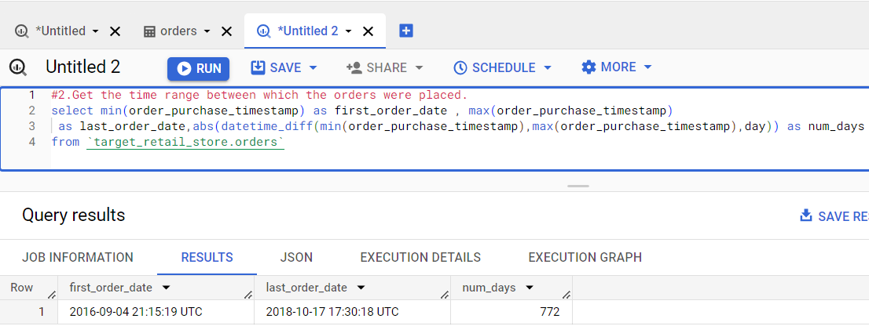
1.2 Get the time range between which the orders were placed.
QUERY:-
select min(order_purchase_timestamp) as first_order_date , max(order_purchase_timestamp) as last_order_date , abs(DATE_DIFF(min(order_purchase_timestamp),max(order_purchase_timestamp) ,DAY)) as num_days
from `target_retail_store.orders`;

Slide 5
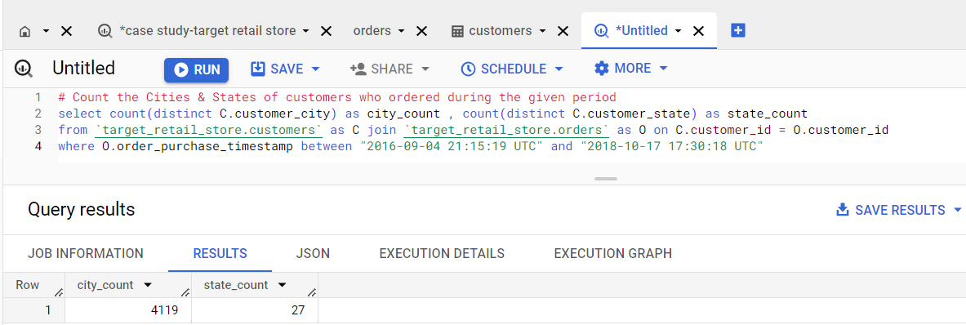
3. Count the Cities & States of customers who ordered during the given period.
QUERY:-
select count (distinct C.customer_city) as city_count , count(distinct C.customer_state) as state_Count
from `target_retail_store.customers` as C join `target_retail_store.orders` as O on C.customer_id = O.customer_id

Slide 6
Insights and recommendations
INSIGHTS:-
Geographic Reach: The target retail store has a significant geographic reach, with orders being placed from a total of 4,119 distinct cities during the analyzed period. This indicates that the store has a wide customer base and is attracting customers from various locations.
Market Expansion Potential: The extensive coverage across 4,119 cities highlights the potential for market expansion. By analyzing the distribution of orders across these cities, the retail store can identify areas where it has a strong presence and areas that may require more attention. This information can help in planning future expansions and targeting new customer segments.
Regional Preferences: Analyzing the distribution of cities and correlating it with sales data can reveal regional preferences and demand patterns. Identifying which cities or regions contribute the most to sales can help the retail store prioritize marketing efforts, optimize inventory management, and tailor product offerings to meet the specific needs of those areas.

Slide 7
Insights and recommendations
RECOMMENDATIONS:-
Targeted Marketing Campaigns: Leveraging the insights gained from the analysis of city and state data, the retail store should create targeted marketing campaigns that focus on specific regions or cities. By understanding the preferences and needs of customers in different areas, the store can develop personalized messaging and promotional offers to increase customer engagement and drive sales.
Expansion Opportunities: The extensive reach across 4,119 cities indicates potential areas for future expansion. The retail store should conduct further research and analysis to identify cities or regions that show high growth potential and align with the store's target market. This can involve evaluating demographic data, market trends, and competition in those areas to make informed decisions about opening new stores or expanding distribution networks.
Localization Strategies: Considering the diversity of cities and states, it is recommended that the retail store implement localization strategies. This involves understanding the unique characteristics, preferences, and cultural aspects of each region and tailoring marketing campaigns, product assortment, and customer experiences accordingly. This approach can help establish stronger connections with local customers and enhance brand loyalty.

Slide 8
2. In-depth Exploration:

Slide 9
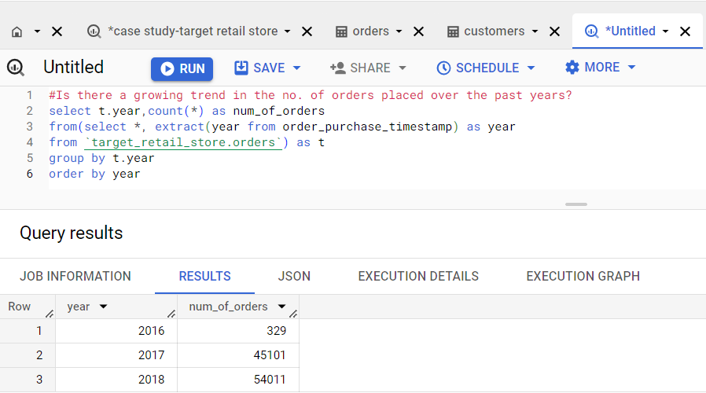
1. Is there a growing trend in the no. of orders placed over the past years?
QUERY:-
select t.year,count(*) as num_of_orders
from(select *, extract(year from order_purchase_timestamp) as year
from `target_retail_store.orders`) as t
group by t.year
order by num_of_orders desc

Slide 10
Insights and recommendations
INSIGHTS:-
Significant Growth: The number of orders placed at the Target retail store has shown a remarkable growth trend over the past few years. Starting with 329 orders in 2016, the store witnessed a substantial increase to 45,101 orders in 2017 and grew to 54,011 orders in 2018. This upward trend indicates a strong demand for the store's products or services.
Market Penetration: The growing number of orders reflects an increasing market penetration for the retail store. As more customers choose to place orders, it indicates a larger customer base and improved brand recognition. This growth can be attributed to factors such as effective advertising, positive word-of-mouth, customer satisfaction, and competitive pricing.
Customer Loyalty and Retention: The consistent growth in the number of orders indicates that the retail store has successfully built customer loyalty and retained its existing customer base. Satisfied customers are likely to make repeat purchases and recommend the store to others, contributing to the continuous growth in orders. Maintaining high levels of customer satisfaction should remain a priority to ensure continued growth.

Slide 11
Insights and recommendations
RECOMMENDATIONS:-
Scalable Infrastructure: To accommodate the growing number of orders, it is recommended for the retail store invest in a scalable infrastructure. This includes upgrading and expanding facilities, optimizing inventory management systems, and streamlining order fulfilment processes. A robust infrastructure will ensure that the store can handle increased order volumes efficiently while maintaining high levels of customer satisfaction.
Enhanced Marketing Efforts: As the trend of growing orders continues, it is essential for the retail store to sustain its marketing efforts. This can include increasing brand visibility through targeted advertising campaigns, expanding digital marketing strategies, and leveraging social media platforms to engage with customers. By consistently promoting the store's products and value proposition, the store can continue to attract new customers and retain existing ones.
Customer Engagement Initiatives: retail stores should focus on customer engagement initiatives to foster customer loyalty and retention. This can involve implementing loyalty programs, offering personalized recommendations based on customer preferences, and providing exceptional customer service. Regular communication with customers through email newsletters or loyalty program updates can help maintain strong relationships and encourage repeat purchases.

Slide 12
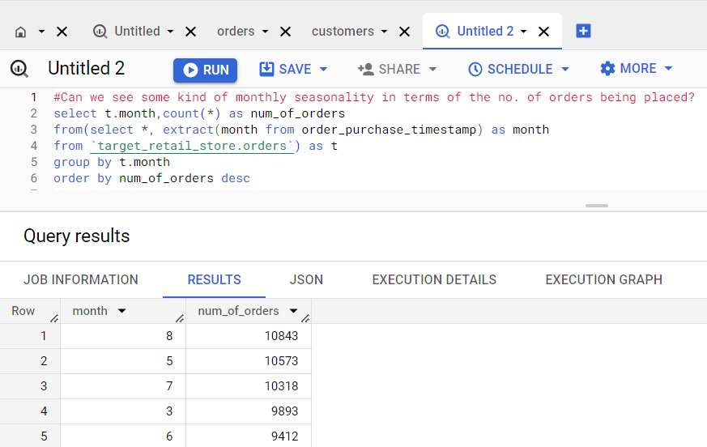
2. Can we see some kind of monthly seasonality in terms of the no. of orders being placed?
QUERY:-
select t.month,count(*) as num_of_orders
from(select *, extract(month from order_purchase_timestamp) as month
from `target_retail_store.orders`) as t
group by t.month
order by num_of_orders desc

Slide 13
Insights and recommendations
INSIGHTS:-
Monthly Variation: The data provided shows variations in the number of orders placed on a monthly basis. This suggests the presence of monthly seasonality, where the demand for the retail store's products or services fluctuates throughout the year.
Peak Seasons: Months 8,5,7,3 and 6 indicate higher order volumes compared to other months. These months may correspond to peak seasons or periods of increased customer activity. It is likely that certain factors, such as holidays, promotional events, or seasonal trends, contribute to the higher number of orders during these months.
Low Seasons: Months 9 and 10 exhibit significantly lower order volumes compared to other months. These months may represent the low season or a period of reduced customer activity. Identifying the reasons for this dip in orders can help the retail store strategize and mitigate the impact of low seasons.
Fluctuating Demand: Understanding the patterns and trends in demand can help the store optimize inventory management, staffing levels, and marketing efforts to meet customer needs effectively.

Slide 14
Insights and recommendations
RECOMMENDATION:-
Seasonal Marketing Campaigns: The retail store can leverage the insights gained from the monthly seasonality to develop targeted marketing campaigns. By identifying peak seasons, the store can create promotional offers, discounts, or exclusive products that align with customers' increased demand. Similarly, during low seasons, the store can design campaigns to incentivize customers and drive sales.
Inventory Management: Recognizing the seasonal fluctuations in demand can assist the retail store in optimizing inventory management. During peak seasons, the store should ensure sufficient stock levels to meet the increased demand. Conversely, during low seasons, the store can adjust inventory levels, reduce costs, and avoid overstocking. Effective inventory management will help maintain customer satisfaction while minimizing unnecessary expenses.
Seasonal Product Offerings: The store can introduce seasonal products or limited-time offerings that align with customer preferences during peak seasons. For example, launching special holiday-themed products or exclusive collections can create a sense of urgency and increase customer engagement. These seasonal product offerings can drive sales and attract new customers during specific months.

Slide 15
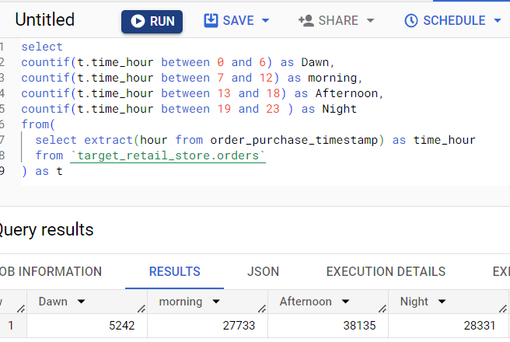
3. During what time of the day, do the Brazilian customers mostly place their orders? (Dawn, Morning, Afternoon or Night) 0-6 hrs: Dawn 7-12 hrs: Mornings 13-18 hrs: Afternoon 19-23 hrs: Night
QUERY:-
select
countif(t.time_hour between 0 and 6) as Dawn,
countif(t.time_hour between 7 and 12) as morning,
countif(t.time_hour between 13 and 18) as Afternoon,
countif(t.time_hour between 19 and 23 ) as Night
from(
select extract(hour from order_purchase_timestamp) as time_hour
from `target_retail_store.orders`
) as t

Slide 16
Insights and recommendations
INSIGHTS:-
Peak Order Time: The data provided indicates that the majority of Brazilian customers place their orders during the afternoon, with a count of 38,135 orders. This suggests that the afternoon is the peak time for order placement among Brazilian customers.
Secondary Order Time: The morning period also shows a significant number of orders, with 27,733 orders being placed. This indicates that the morning is the second most popular time for Brazilian customers to place their orders.
Moderate Order Time: The night period follows closely behind the morning, with 28,331 orders. Although it falls behind the afternoon and morning, it still represents a substantial portion of customer order activity.
Least Popular Order Time: The dawn period has the lowest number of orders, with 5,242 orders. This suggests that Brazilian customers are less likely to place orders during the early hours of the day.

Slide 17
Insights and recommendations
RECOMMENDATIONS:-
Promotional Campaigns: The retail store can strategically design promotional campaigns targeted at specific order times to incentivize customers. For example, offering time-limited discounts or promotions during the morning or night periods can encourage more orders during these times. This approach can help distribute customer orders more evenly throughout the day and optimize operational efficiency.
Customer Communication: The store can proactively communicate with customers to remind them of the most popular order times and highlight the benefits of placing orders during less crowded periods. This can be done through email newsletters, social media posts, or personalized notifications. By promoting order placement during off-peak times, the store can help balance the order volume and reduce potential bottlenecks during peak periods.
Geographic Considerations: While focusing on the overall Brazilian customer behaviour, it's important to take regional variations into account. Different regions within Brazil may have different cultural or lifestyle patterns that influence order placement times. Conducting regional analysis and targeting specific areas with tailored marketing campaigns can help capture local customer preferences and optimize order placement strategies accordingly.

Slide 18
3. Evolution of E-commerce orders in the Brazil region:

Slide 19
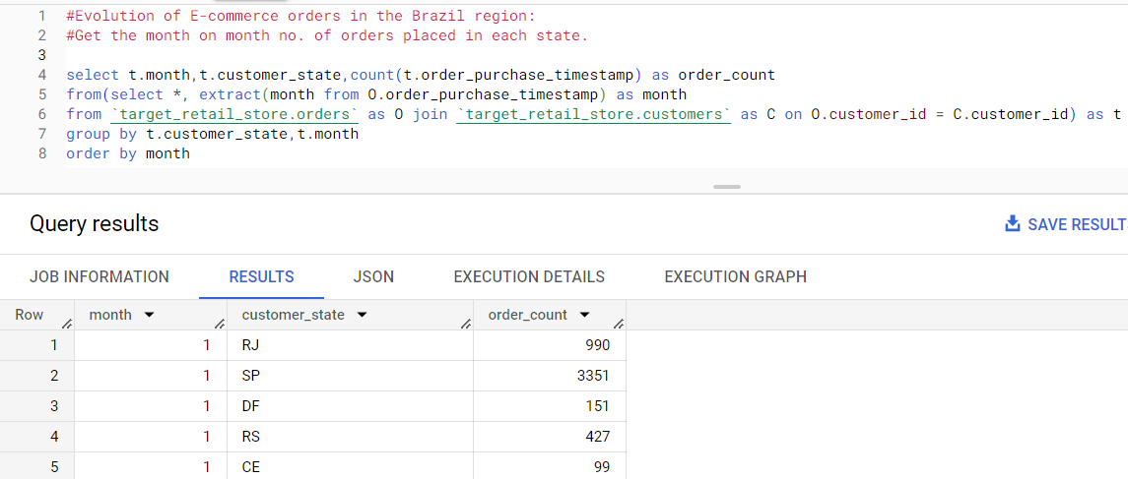
1. Get the month-on-month no. of orders placed in each state.
QUERY:- select t.month,t.customer_state,count(t.order_purchase_timestamp) as order_count
from(select *, extract(month from O.order_purchase_timestamp) as month
from `target_retail_store.orders` as O join `target_retail_store.customers` as C on O.customer_id = C.customer_id) as t
group by t.customer_state,t.month
order by t.month

Slide 20
Insights and recommendations
INSIGHTS:-
Order Variation: The data provide insights into the month-on-month variation in the number of orders placed in different states. By analyzing this data, we can identify trends and patterns in customer behaviour and order volumes across states.
State-Specific Trends: The month-on-month variation reveals that different states may exhibit unique order patterns. Some states may experience consistent growth or stability in order volumes, while others may show fluctuations or seasonal trends.
High-Performing States: These states may represent key markets for the target retail stores, indicating strong customer demand and market penetration.
Low-Performing States: These states may require further analysis to understand the reasons behind the lower demand. It could be due to factors such as competition, economic conditions, or customer preferences.

Slide 21
Insights and recommendations
RECOMMENDATIONS:-
Regional Marketing Strategies: Develop region-specific marketing strategies to address the unique characteristics and preferences of customers in different states. Customize promotions, advertising, and product assortments to resonate with local customer bases. This approach can help target retail stores establish a strong presence and connect with customers on a more personal level.
Customer Feedback and Engagement: Encourage customers to provide feedback on their shopping experiences, products, and services. Actively listen to customer opinions and preferences to better understand their needs and adapt offerings accordingly. Regularly engage with customers through surveys, social media, or customer loyalty programs to gather insights and build stronger relationships.
Collaboration with Local Influencers: Collaborate with influencers or local celebrities from specific states to promote the target retail stores. Partnering with influential individuals who have a strong presence in certain regions can help increase brand visibility and credibility among local customers.

Slide 22
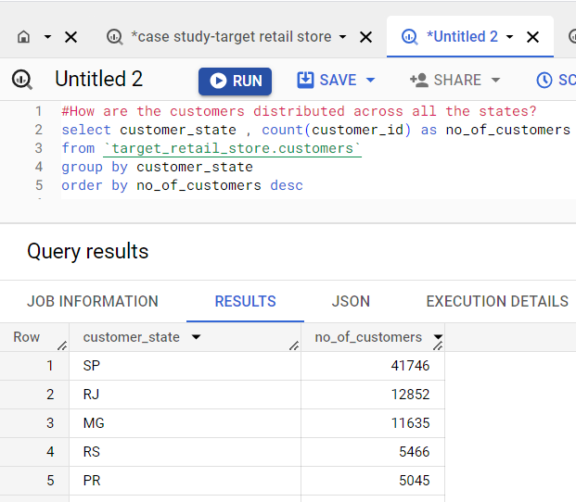
2.) How are the customers distributed across all the states?
QUERY:-
select distinct customer_state , count(distinct customer_id) as no_of_customers
from `target_retail_store.customers`
group by customer_state
order by no_of_customers desc

Slide 23
Insights and recommendations
RECOMMENDATIONS:-
Market Expansion: Given the significant customer base in São Paulo, consider focusing on expanding operations and increasing market penetration in this state. This can include opening new stores, enhancing marketing efforts, and strengthening the brand presence to cater to the high demand in this market.
Targeted Marketing: Develop targeted marketing campaigns for states with substantial customer bases, such as Rio de Janeiro and Minas Gerais. Customize advertising, promotions, and product offerings to resonate with the preferences and needs of customers in these states, effectively capturing market share and driving customer engagement.
Regional Analysis: Conduct in-depth regional analysis for states with smaller customer bases, like Rio Grande do Sul and Paraná. Identify the reasons for the comparatively lower customer numbers and evaluate opportunities to increase market reach, such as refining marketing strategies or exploring partnerships with local businesses

Slide 24
4. Impact on Economy: Analyze the money movement by e-commerce by looking at order prices, freight and others.

Slide 25
1.) Get the % increase in the cost of orders from the year 2017 to 2018 (include months between Jan to Aug only).
QUERY:-
with cte as
(
select P.payment_value , extract(year from O.order_purchase_timestamp ) as date_year
from `target_retail_store.orders` as O join `target_retail_store.payments` as P on O.order_id = P.order_id
where O.order_purchase_timestamp between "2017-01-01" and "2017-08-31"
union all
select P.payment_value , extract(year from O.order_purchase_timestamp ) as date_year
from `target_retail_store.orders` as O join `target_retail_store.payments` as P on O.
order_id = P.order_id
where O.order_purchase_timestamp between "2018-01-01" and "2018-08-31"),
cte2 as (
select sum(
case when date_year = 2017 then payment_value else 0 end) as total_spend_2017,
sum(
case when date_year = 2018 then payment_value else 0 end) as total_spend_2018
from cte
)
select round(total_spend_2017,2) as total_spend_2017,round(total_spend_2018,2) as total_spend_2018 ,round((total_spend_2018 - total_spend_2017)* 100 / total_spend_2017,2) as percentage_increase
from cte2

Slide 26
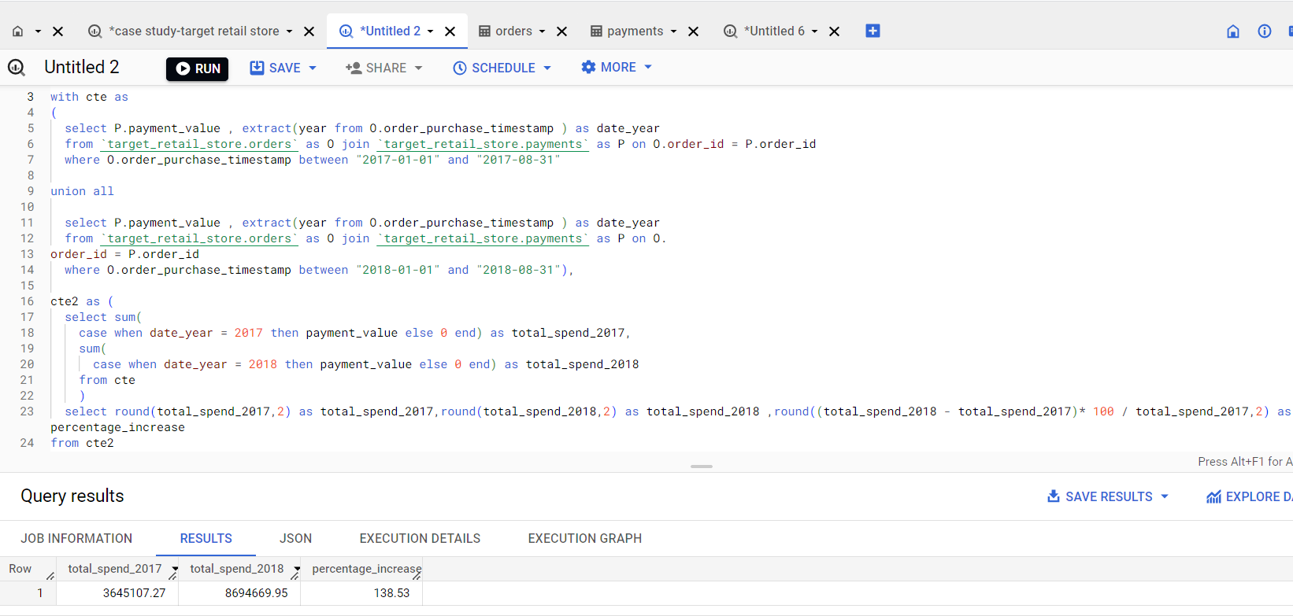
SCREENSHOT:-

Slide 27
Insights and recommendations
INSIGHTS:-
Significant Increase: The cost of orders experienced a substantial increase of approximately 138.56% from the year 2017 to 2018 during the months between January and August. This indicates a significant growth in customer spending during this period.
RECOMMENDATIONS:-
Capitalize on Increased Spending: The target retail store should leverage the observed increase in customer spending to drive further growth. Develop marketing strategies that highlight new products, exclusive offers, or loyalty programs to encourage customers to continue spending and attract new customers.
Loyalty Programs and Incentives: Develop or enhance loyalty programs to reward frequent customers and incentivize repeat purchases. Offer exclusive discounts, early access to new products, or personalized recommendations to encourage customers to continue shopping at the Target retail store.
Omni-channel Approach: Provide a seamless shopping experience across multiple channels, including physical stores, online platforms, and mobile applications. Enable customers to conveniently browse, purchase, and receive their orders through their preferred channels.

Slide 28
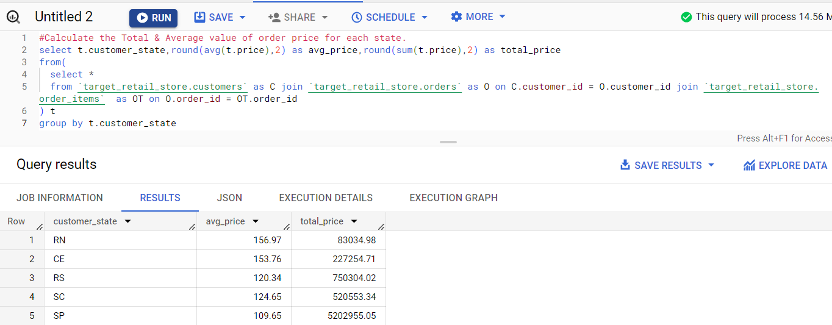
2.) Calculate the Total & Average value of the order price for each state.
QUERY:-
select t.customer_state,round(avg(t.price),2) as avg_price,round(sum(t.price),2) as total_price
from(
select *
from `target_retail_store.customers` as C join `target_retail_store.orders` as O on C.customer_id = O.customer_id join `target_retail_store.order_items` as OT on O.order_id = OT.order_id
) t
group by t.customer_state

Slide 29
Insights and recommendations
INSIGHTS:-
Average Order Price: The average order price varies across different states. States such as RN (Rio Grande do Norte) and CE (Ceará) have relatively higher average order prices compared to other states, indicating potentially higher-value purchases by customers in these regions.
Total Order Price: The total order price represents the cumulative value of all orders placed in each state. States such as RS (Rio Grande do Sul), SC (Santa Catarina), and SP (São Paulo) have higher total order prices, indicating a larger volume of sales and potentially stronger market presence.
Regional Differences: The variation in average and total order prices suggests regional differences in customer preferences, economic factors, and market dynamics. Understanding these regional variations is crucial for tailoring marketing strategies and optimizing business operations to cater to specific regional needs.

Slide 30
Insights and recommendations
RECOMMENDATIONS:-
Upselling and Cross-selling: Leverage the higher average order prices in certain states to implement upselling and cross-selling techniques. Identify complementary products or higher-value alternatives to suggest to customers during their purchase journey, increasing the average order value.
Customer Retention: Implement customer retention strategies to encourage repeat purchases and increase the total order price. Offer loyalty programs, personalized recommendations, or exclusive discounts to reward and incentivize loyal customers in states with higher total order prices.
Customer Experience Enhancement: Invest in enhancing the overall customer experience, including user-friendly website design, smooth checkout processes, and responsive customer support. A positive and seamless experience can encourage customers to spend more and contribute to higher average order prices.

Slide 31
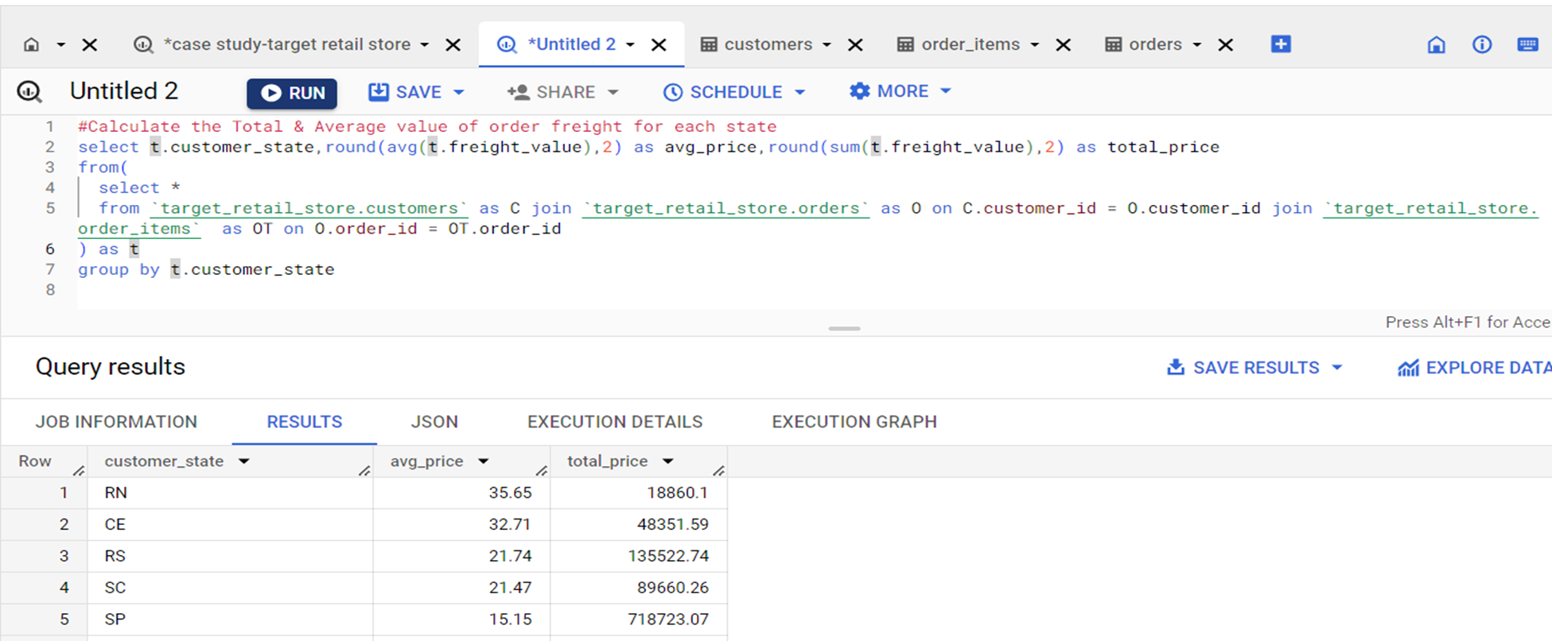
3.) Calculate the Total & Average value of order freight for each state
QUERY:-
select t.customer_state,round(avg(t.freight_value),2) as avg_price,round(sum(t.freight_value),2) as total_price
from(
select *
from `target_retail_store.customers` as C join `target_retail_store.orders` as O on C.customer_id = O.customer_id join `target_retail_store.order_items` as OT on O.order_id = OT.order_id
) as t
group by t.customer_state

Slide 32
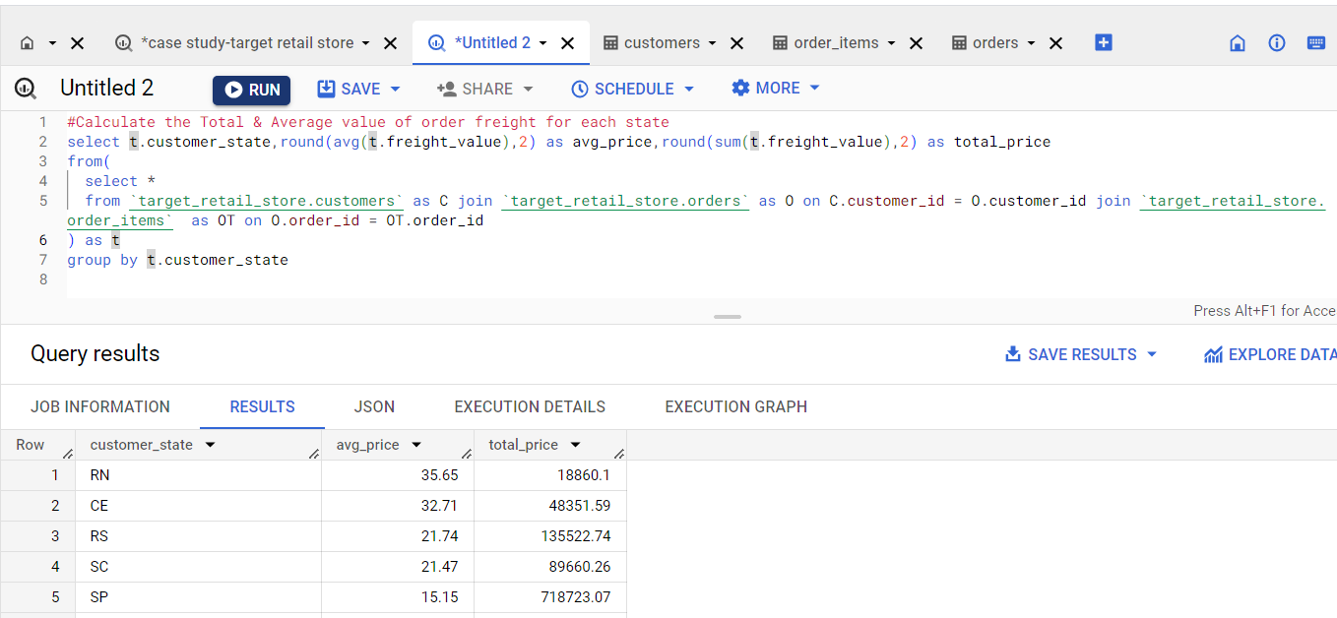
SCREENSHOT:-

Slide 33
Insights and recommendations
INSIGHTS:-
Average Freight Value: The average value of order freight varies across different states. States such as RN (Rio Grande do Norte) and CE (Ceará) have relatively lower average freight values, indicating potentially lower shipping costs for customers in these regions. On the other hand, states like RS (Rio Grande do Sul) and SC (Santa Catarina) have higher average freight values, suggesting potentially higher shipping costs for customers in those areas.
Total Freight Value: The total freight value represents the cumulative shipping costs for all orders placed in each state. States such as RS and SC have higher total freight values, indicating a larger volume of shipments and potentially greater logistical challenges due to the larger size or distance involved in delivering orders to these regions.

Slide 34
Insights and recommendations
RECOMMENDATIONS:-
Cost Optimization: Evaluate the freight pricing structure and negotiate with logistics partners to optimize shipping costs in states with higher average freight values, such as RS and SC. Look for opportunities to streamline shipping processes, negotiate better rates, or explore alternative shipping methods to reduce overall freight expenses.
Shipping Incentives: Consider implementing shipping incentives, such as free or discounted shipping thresholds, to encourage customers to place larger orders. This can help offset higher shipping costs and increase the average order value while also providing an incentive for customers to continue shopping at the Target retail store.
Regional Warehousing: Explore the possibility of establishing regional warehouses or fulfilment centres in states with higher average and total freight values, like RS and SC. This can help reduce shipping distances, decrease transit times, and potentially lower shipping costs for both the retail store and its customers in these regions.
Carrier Options: Assess the carrier options available for shipping orders in each state. Consider partnering with multiple carriers to ensure competitive pricing, efficient delivery services, and the ability to cater to customers in different regions effectively. Regularly review carrier performance to ensure the best possible shipping experience for customers.

Slide 35
5. Analysis based on sales, freight and delivery time.

Slide 36
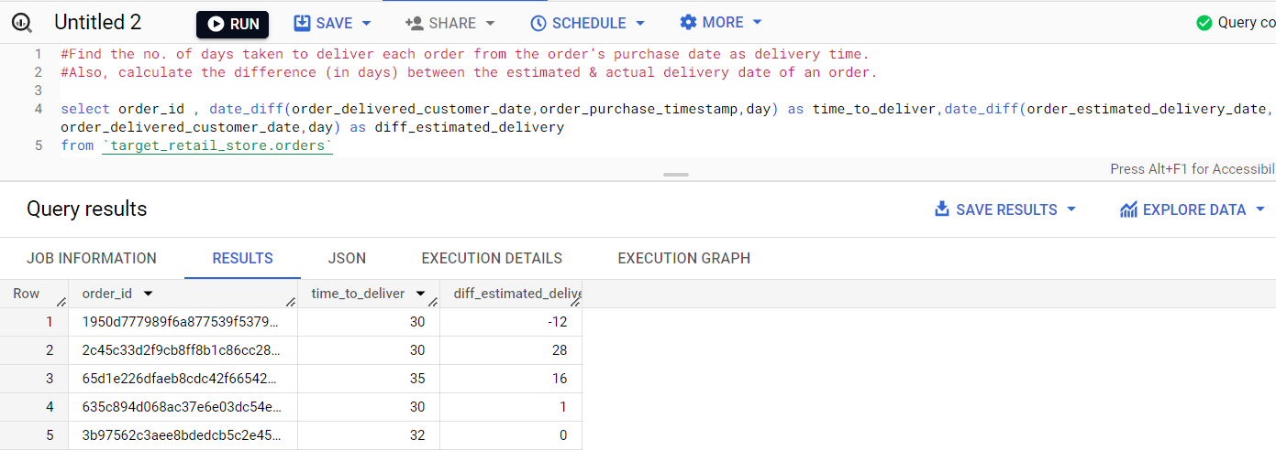
1. Find the no. of days taken to deliver each order from the order’s purchase date as delivery time. Also, calculate the difference (in days) between the estimated & actual delivery date of an order
QUERY:-
select order_id , date_diff(order_delivered_customer_date,order_purchase_timestamp,day) as deliver_time_diff,date_diff(order_estimated_delivery_date,order_delivered_customer_date,day) as estimated_time_diff
from `target_retail_store.orders`

Slide 37
Insights and recommendations
INSIGHTS:-
By analyzing the delivery time and the difference between the estimated and actual delivery dates for each order, we can gain insights into the efficiency of the target retail store's delivery process and identify any potential delays or issues.
RECOMMENDATIONS:-
Streamline Logistics Operations: Evaluate the current logistics processes and identify areas where improvements can be made to reduce delivery time. Streamline warehouse operations, optimize inventory management, and enhance coordination with shipping partners to ensure faster order fulfilment and delivery.
Realistic Estimated Delivery Dates: Improve the accuracy of estimated delivery dates provided to customers. Consider factors such as distance, shipping carrier capabilities, and potential delays to provide more realistic delivery timeframes. Setting realistic expectations can help minimize customer dissatisfaction due to delays.
Proactive Communication: Establish effective communication channels with customers to provide timely updates regarding the status of their orders. Proactively inform customers about any potential delays or changes in estimated delivery dates. This level of transparency and communication can help manage customer expectations and build trust.

Slide 38
2. Find out the top 5 states with the highest & lowest average freight value.
QUERY:-
select * from
(select t.customer_state , t.avg_frieght_value,dense_rank()over(order by t.avg_frieght_value desc) as high_rank_no
from(
select C.customer_state , round(avg(OT.freight_value),2) as avg_frieght_value
from `target_retail_store.customers` as C join `target_retail_store.orders` as O on C.customer_id = O.customer_id join `target_retail_store.order_items` as OT on O.order_id = OT.order_id
group by C.customer_state
order by avg_frieght_value desc
) as t) as a
join
(select x.customer_state , x.avg_frieght_value, dense_rank()over(order by x.avg_frieght_value) as low_rank_no
from(
select C.customer_state , round(avg(OT.freight_value),2) as avg_frieght_value
from `target_retail_store.customers` as C join `target_retail_store.orders` as O on C.customer_id = O.customer_id join `target_retail_store.order_items` as OT on O.order_id = OT.order_id
group by C.customer_state
order by avg_frieght_value desc
) as x) as b
on a.high_rank_no = b.low_rank_no
order by high_rank_no
limit 5;

Slide 39
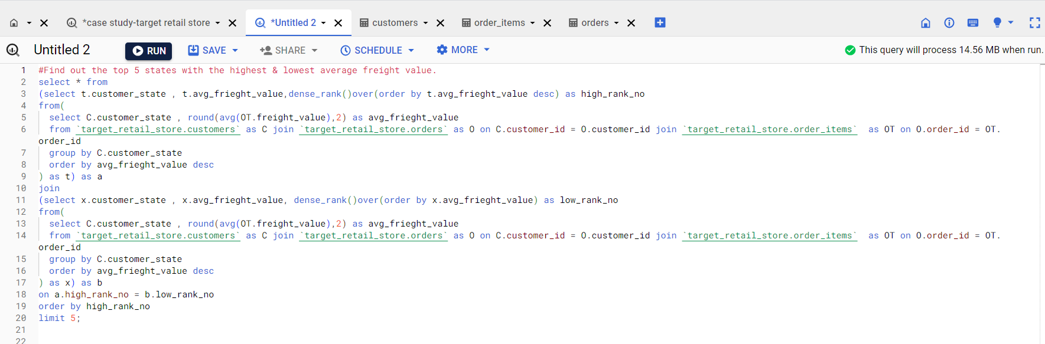
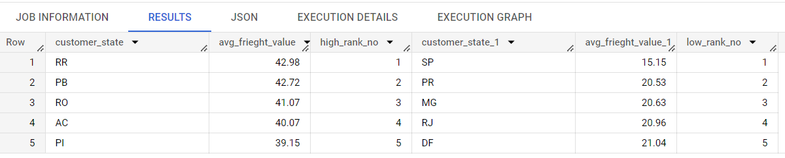
SCREENSHOT:-

Slide 40
Insights and recommendations
INSIGHTS:-
Analyzing the average freight value for different states in Brazil provides insights into the shipping costs and logistics efficiency in each region. Identifying the top 5 states with the highest and lowest average freight values allows us to understand the variations in shipping expenses across the country.
RECOMMENDATIONS:-
Assess Shipping Processes: Investigate the reasons behind the higher average freight values in these states. Evaluate the shipping processes, carrier options, and logistical challenges specific to each region. Identify potential areas for improvement to optimize shipping costs and reduce the average freight values.
Negotiate Shipping Rates: Engage in negotiations with shipping carriers to secure more favourable rates for these states. Explore partnerships with carriers specializing in these regions to capitalize on their expertise and potentially negotiate better pricing terms.
Optimize Packaging: Review packaging practices to ensure efficient use of space and minimize the weight and dimensions of shipments. Proper packaging can help reduce freight costs, particularly for regions with higher average freight values.

Slide 41
3.) Find out the top 5 states with the highest & lowest average delivery time.
QUERY:-
select * from(
(
select t1.customer_state,t1.avg_day_diff,rank()over(order by t1.avg_day_diff) as low_to_high_rank
from(
select C.customer_state , avg(date_diff(O.order_delivered_customer_date,O.order_purchase_timestamp,day)) avg_day_diff
from `target_retail_store.customers` as C join `target_retail_store.orders` as O on C.customer_id = O.customer_id
group by C.customer_state
) as t1
) as A
join
(
select t2.customer_state,t2.avg_day_diff,rank()over(order by t2.avg_day_diff desc) as high_to_low_rank
from(
select C.customer_state , avg(date_diff(O.order_delivered_customer_date,O.order_purchase_timestamp,day)) avg_day_diff
from `target_retail_store.customers` as C join `target_retail_store.orders` as O on C.customer_id = O.customer_id
group by C.customer_state
) as t2
) as B
on A.low_to_high_rank = B.high_to_low_rank)
order by A.low_to_high_rank
limit 5;

Slide 42
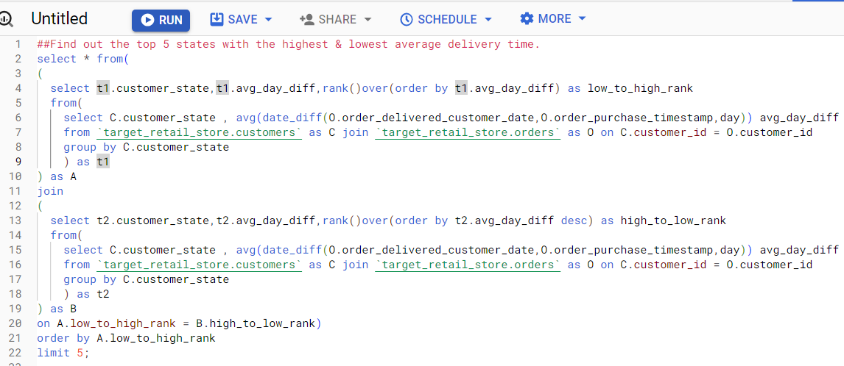
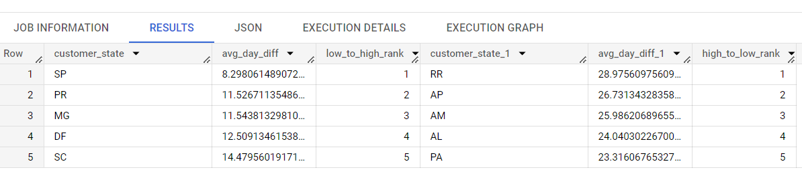
SCREENSHOT:-

Slide 43
Insights and recommendations
INSIGHTS:-
Analyzing the average delivery time for different states in Brazil provides insights into the efficiency of the delivery process in each region. Identifying the top 5 states with the highest and lowest average delivery times allows us to understand variations in delivery speed and potential challenges.
RECOMMENDATIONS:-
Carrier Selection: Evaluate the performance of shipping carriers in these states. Assess their delivery capabilities, reliability, and transit times. Consider partnering with carriers that offer faster delivery services or have a strong presence in these regions to expedite the shipping process.
Proactive Communication: Enhance communication with customers regarding their orders. Provide regular updates on the status of shipments, estimated delivery dates, and any potential delays. Proactively notify customers of any changes or issues that may affect delivery times to manage expectations effectively.
Last-Mile Delivery Optimization: Collaborate with shipping partners to optimize last-mile delivery operations. Explore strategies such as route optimization, geolocation tracking, and local distribution centres to improve delivery speed and accuracy.

Slide 44
4.) Find out the top 5 states where the order delivery is really fast as compared to the estimated date of delivery.
QUERY:-
select t.customer_state,t.avg_diff,dense_rank()over(order by t.avg_diff) as rank_no
from(
select C.customer_state, round(avg(date_diff(O.order_estimated_delivery_date,O.order_delivered_customer_date,day)),2) as avg_diff
from `target_retail_store.customers` as C join `target_retail_store.orders` as O on C.customer_id = O.customer_id
group by C.customer_state
) as t
order by rank_no
limit 5

Slide 45
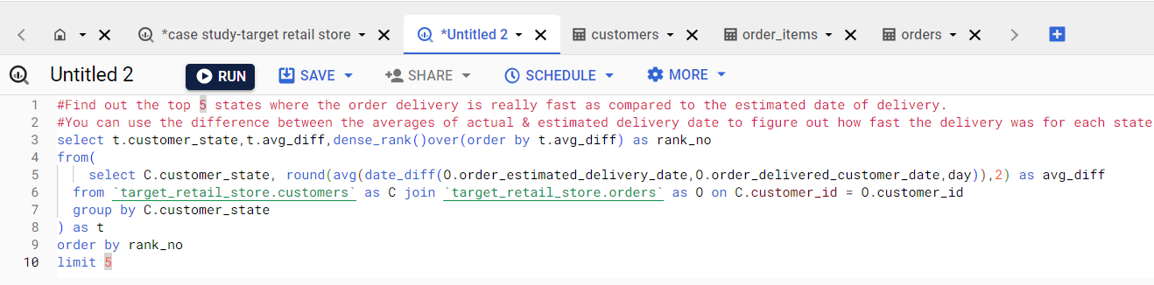
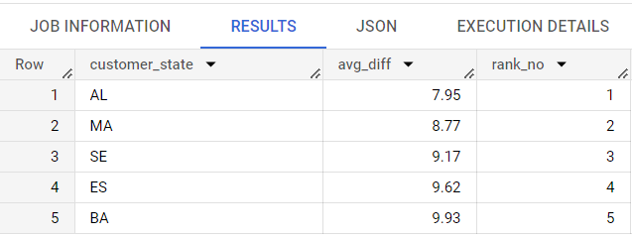
SCREENSHOT:-

Slide 46
Insights and recommendations
INSIGHTS:-
Analyzing the top 5 states where the order delivery is faster than the estimated date of delivery provides insights into the efficiency of the delivery process in these regions. It highlights the states where the target retail store excels in meeting or surpassing customer expectations in terms of delivery speed.
RECOMMENDATIONS:-
Evaluate Success Factors: Analyze the factors contributing to the fast delivery in these states. Identify the best practices, operational strategies, and partnerships that enable quicker order fulfilment and delivery. Understand the reasons behind their success and consider implementing similar approaches in other regions.
Share Best Practices: Foster knowledge sharing and collaboration among the target retail store's logistics teams and carriers operating in different regions. Encourage the exchange of best practices and successful delivery strategies to improve delivery times across all states.
Collaborate with Efficient Carriers: Strengthen partnerships with carriers known for their efficient delivery services in these states. Regularly assess carrier performance and service quality to ensure consistent and reliable delivery experiences for customers. Consider expanding partnerships with these carriers to other regions to improve delivery efficiency.

Slide 47
6.) Analysis based on the payments:

Slide 48
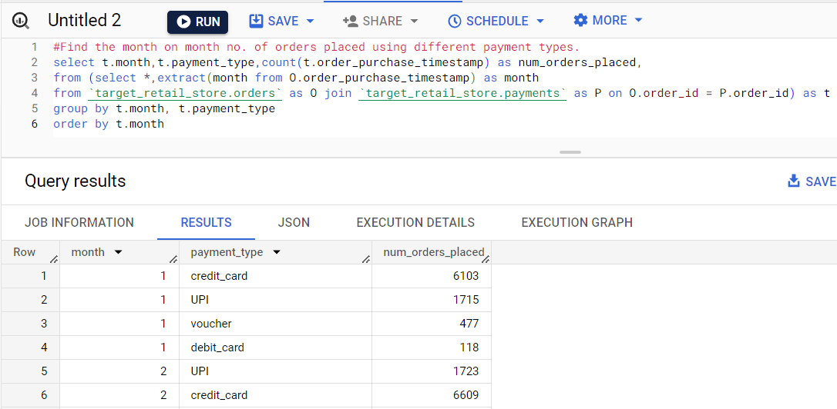
1.) Find the month-on-month no. of orders placed using different payment types.
QUERY:
select t.month,t.payment_type,count(t.order_purchase_timestamp) as num_orders_placed,
from (select *,extract(month from O.order_purchase_timestamp) as month
from `target_retail_store.orders` as O join `target_retail_store.payments` as P on O.order_id = P.order_id) as t
group by t.month, t.payment_type
order by t.month

Slide 49
Insights and recommendations
INSIGHTS:-
Analyzing the month-on-month number of orders placed using different payment types provides insights into customer preferences and payment trends. It helps understand how customers choose to pay for their orders and if any specific payment methods are more popular during certain months.
RECOMMENDATIONS:-
Promote Preferred Payment Methods: Identify the payment methods that are most popular among customers and proactively promote them. Offer incentives or discounts for using these preferred payment methods to encourage their adoption. This can help streamline the payment process and enhance the overall customer experience.
Diversify Payment Options: Consider expanding the range of payment options available to customers. Offer a variety of payment methods such as credit cards, debit cards, digital wallets, and bank transfers to cater to different customer preferences. Stay updated with emerging payment technologies and provide secure and convenient options to attract a wider customer base.
Seamless Checkout Experience: Focus on providing a seamless and user-friendly checkout experience regardless of the payment method chosen. Optimize the online payment process, minimize any technical issues or glitches, and ensure smooth integration with payment gateways. A smooth checkout experience contributes to higher customer satisfaction and encourages repeat purchases.

Slide 50
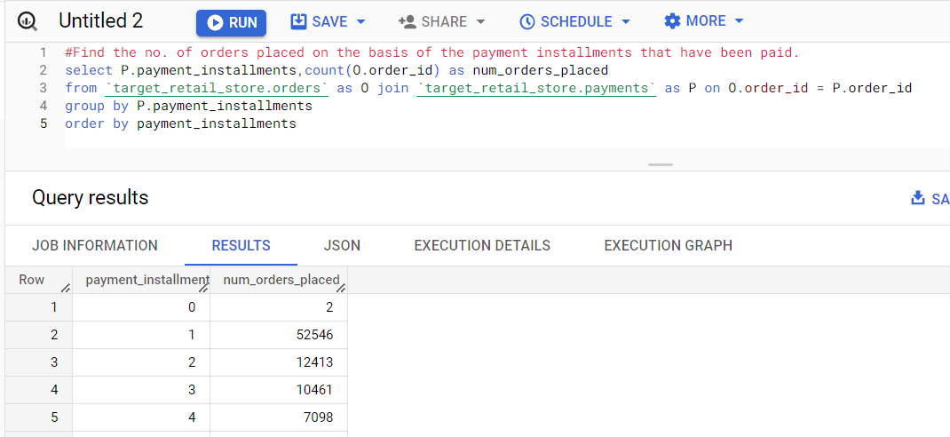
2.) Find the no. of orders placed on the basis of the payment instalments that have been paid
QUERY:
select P.payment_installments,count(O.order_id) as num_orders_placed
from `target_retail_store.orders` as O join `target_retail_store.payments` as P on O.order_id = P.order_id
group by P.payment_installments
order by payment_installments

Slide 51
Insights and recommendations
INSIGHTS:-
The provided data allows us to understand the number of orders placed based on the payment instalments that have been paid. By analyzing this information, we can gain insights into customer behaviour regarding payment methods and instalment plans.
RECOMMENDATIONS:-
Customer Education: Educate customers about the benefits and flexibility of instalment payment options. Highlight the convenience and affordability of paying in instalments, especially for higher-priced products or larger orders.
Collaborate with Payment Providers: Collaborate with payment providers or financial institutions to offer attractive instalment plans and promotions. Partnering with payment processors or credit providers can expand the range of instalment options available to customers and enhance their purchasing experience.
Continuous Monitoring and Improvement: Continuously monitor customer preferences regarding payment instalments and keep track of any shifts or changes in behaviour. Regularly assess the effectiveness of marketing strategies and payment options to identify areas for improvement and adapt to evolving customer needs.

